Slide 1
ANTIRETROVIRAL THERAPY
MANAGEMENT OF HIV/aids

Slide 2
History
First discovered on June 5, 1981 in 5 homosexual men in LA.
First given the name GRID—Gay-Related Immune Deficiency. Changed to AIDS in 1982 when it was realized that over half of the people infected were not homosexual men.
French and American scientists discovered the virus that caused AIDS within a year of each other.
President Reagan and President Mitterrand met and agreed on the name of the virus – Human Immunodeficiency Virus (HIV).

Slide 3
HIV-1 is thought to have been first transmitted to humans by wild chimpanzees in Cameroon.
HIV-2 is believed to have been transmitted by the Old World monkey Sooty Mangabey.
The three earliest known findings of the HIV are:
  Plasma taken from a male in the Congo in 1959
  In tissue taken from a 15 year old in St. Louis—he died in 1969
  In tissue taken from a Norwegian sailor who died in 1976
First documented case in Uganda
  1982 Dr. Anthony Lwegaba at Kalisizo Health Center, Rakai District
HIV is the commonest cause of death among the young adults aged 20-45 years.

Slide 4
EPIDEMIOLOGY OF HIV/AIDS

Slide 5
Global picture
Global percentage of adults living with HIV has leveled off since 2000.
In 2007 there were 33million persons living with HIV
  2.7 million new HIV infections
  2 million HIV-related deaths.
  Marked increase in treatment access
  50% are women
Sub-Saharan Africa remains the most heavily affected
  Accounts for 67% of all infections
  75% of AIDS deaths
Notes:
Source: UNAIDS 2008 Report

Slide 6
Uganda HIV/AIDS Burden
Country prevalence is at 6.3% (5.8 – 6.8%)
  Highest in Kampala, Mbarara & Commercial districts (~10 – 15%)
  Lowest in West Nile region (~0.5 – 4%)
About 1.4million persons are estimated to be living with HIV
  ~150,000 children
  ~600,000 in need of care
  154,000 receiving ART as opposed to 320,000 in need by Dec 2008
New infection highest among married couples
Notes:
Sources: Wolfgang et al 2007; MoH ACP report, Uganda PEPFAR Sept. 2008 APR

Slide 7
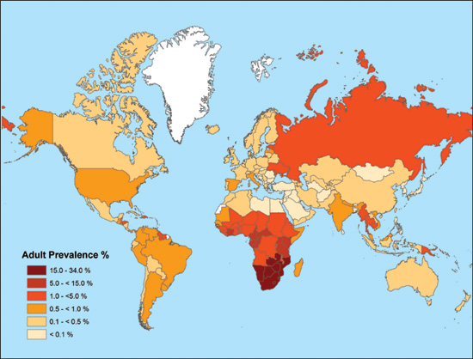

Slide 8
HIV/AIDS

Slide 9
HIV = Human Immunodeficiency Virus
HIV is an RNA virus which contains two identical strands of (+)ssRNA in its capsid.
HIV is a retrovirus (i.e. viral RNS serves as template for the synthesis of a complementary DNA)
HIV infection usually progresses to AIDS

Slide 10
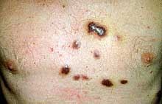
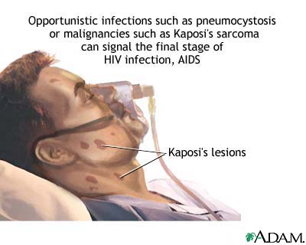
AIDS = Acquired Immunodeficiency Syndrome.
This stage of HIV infection is usually characterized by opportunistic diseases, including Pneumocystis carinii pneumonia, Kaposi sarcoma, cytomegalovirus disease, etc.

Slide 11
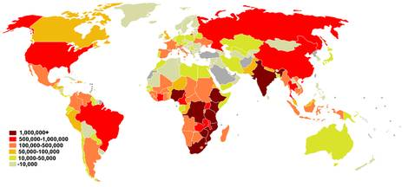
HIV-1 is responsible for AIDS in America, Europe, and Asia
HIV-2 occurs mainly in western Africa
At present, anti-HIV drugs are aimed at two targets: reverse transcriptase and HIV protease.

Slide 12

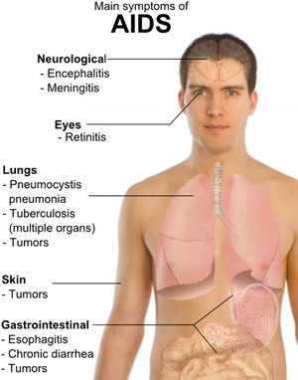

Slide 13
Virology of HIV
RNA virus:
  Family: Retroviridae
  Genus: Lentivirus
  Species: HIV-1, HIV-2, SIV
Multiple genotypic subtypes or recombinants
  Genotypes have different geographical distribution
Genetic diversity of HIV-1 is important, as treatments and vaccines may not be equally effective against different subtypes

Slide 14
Structure
Consists of a cylindrical centre surrounded by a sphere shaped envelope
Sphere comprises two single strands of RNA with associated proteins
The envelope is a membrane comprising a lipid bi-layer

Slide 15
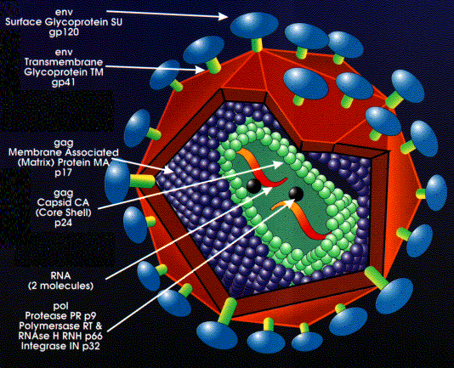

Slide 16
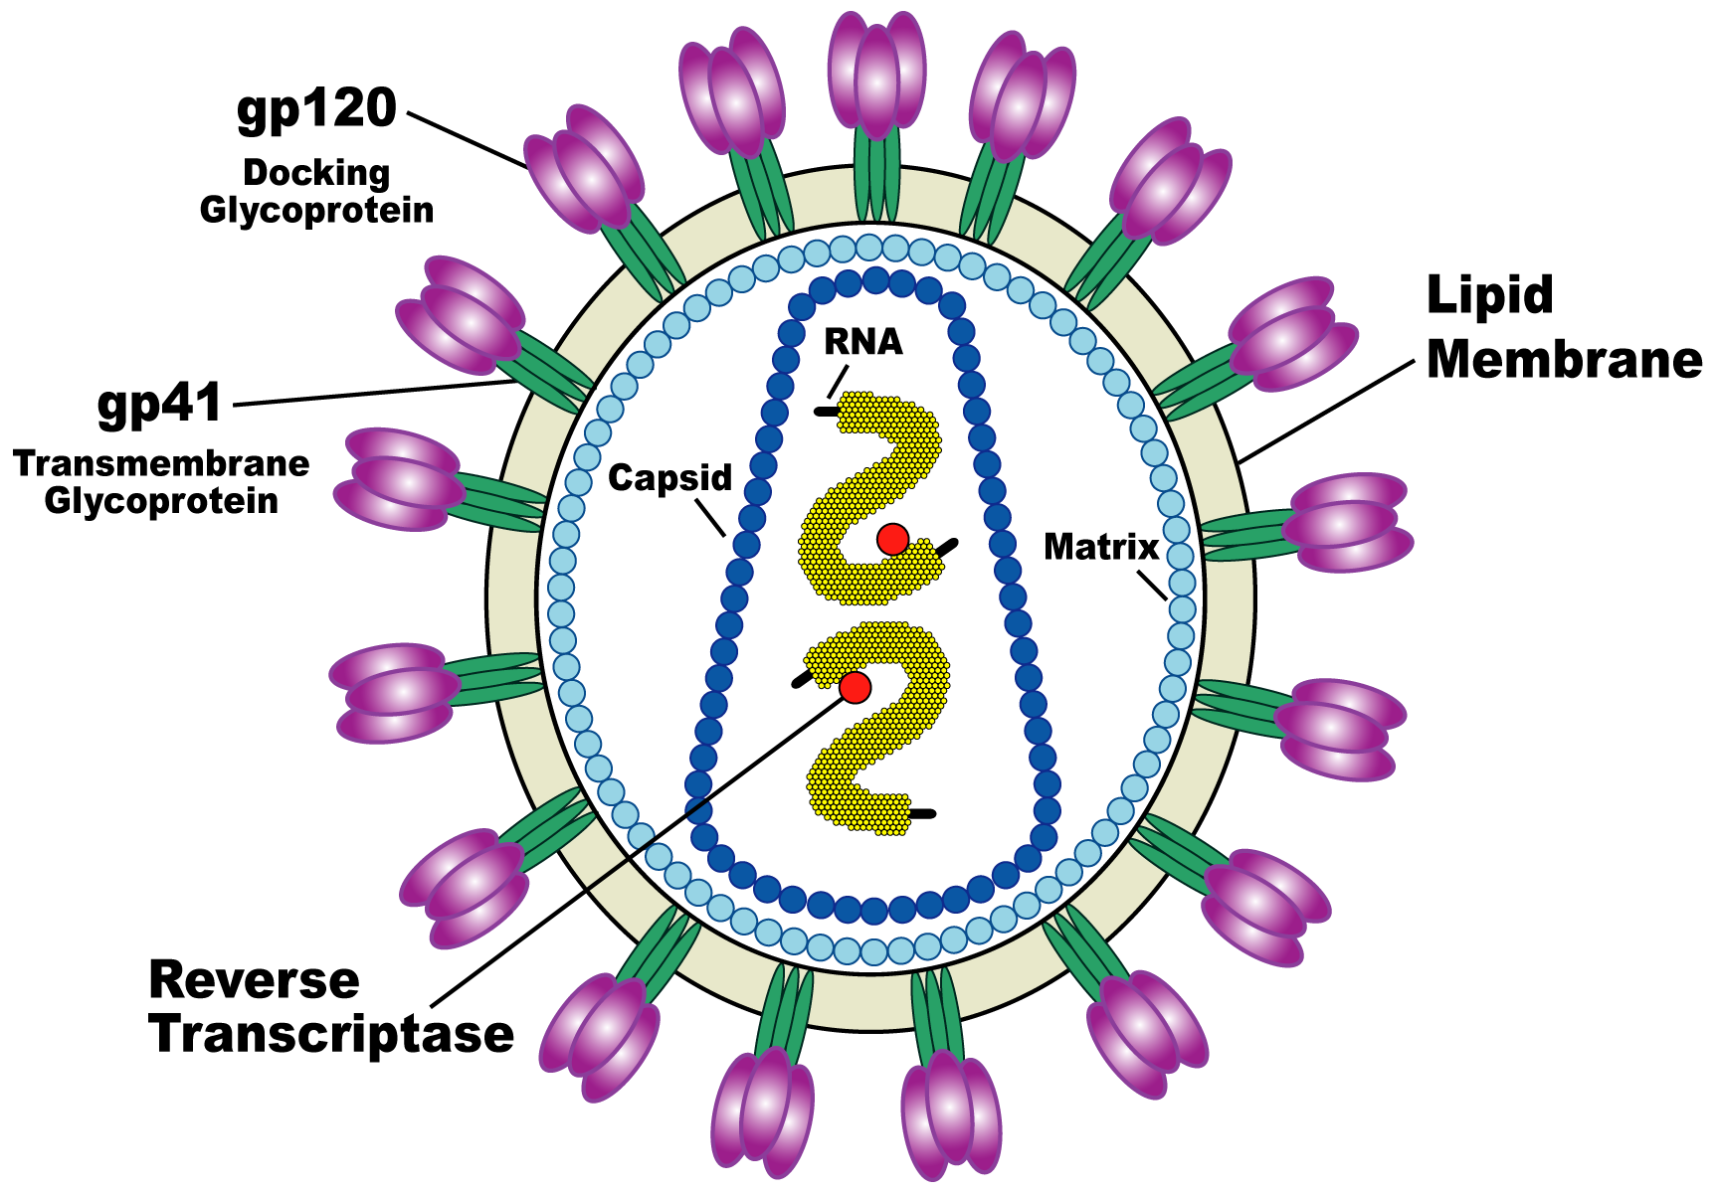
Structure and life cycle of HIV
HIV is a retrovirus
  Contains two strands of (+)ssRNA
Contains reverse transcriptase and integrase.
  Integrase helps in the insertion of HIV DNA into host DNA
Infects helper T cells and macrophages—immune system cells

Slide 17
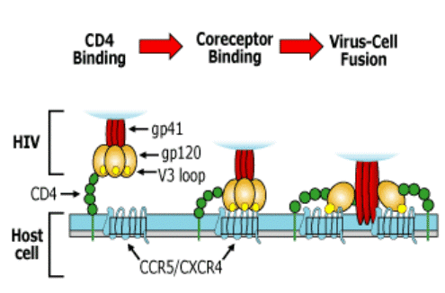

Slide 18
The outer membrane contains the proteins gp120 and gp41. Both are important to adsorption and penetration.
Gp120 binds to the transmembrane protein CD4 on the host cell and then is removed by conformational changes.
Gp41 then pulls the virus and host cell together allowing the membranes to fuse.
The capsid breaks down and the viral RNA and enzymes are release into the cell.
Reverse transcriptase converts the viral RNA into DNA. This DNA is known as proviral DNA
Integrase inserts the proviral DNA into the host’s DNA. Once the proviral DNA is part of the host’s DNA, it is known as the provirus and can remain dormant in the DNA

Slide 19
When the provirus is transcribed, three main genes are transcribed: env, gag, and pol.
Three non-functional poly-proteins are made from these genes, one from the env gene, one from the gag gene, and the last one is from a combination of the gag and pol genes.
The first produces gp120 and gp41 which are placed onto the cell membrane. The other two poly-proteins move to the inner cell membrane and block out host membrane proteins. Budding occurs in this region of the membrane.
The gag-pol protein releases protease by autocatalysing the gag-pol protein. Protease then cleaves reverse transcriptase, integrase, and other proteins.
The capsid forms, with all viral RNA, essential enzymes, and proteins in it. The complete virus then leaves the host cell.

Slide 20
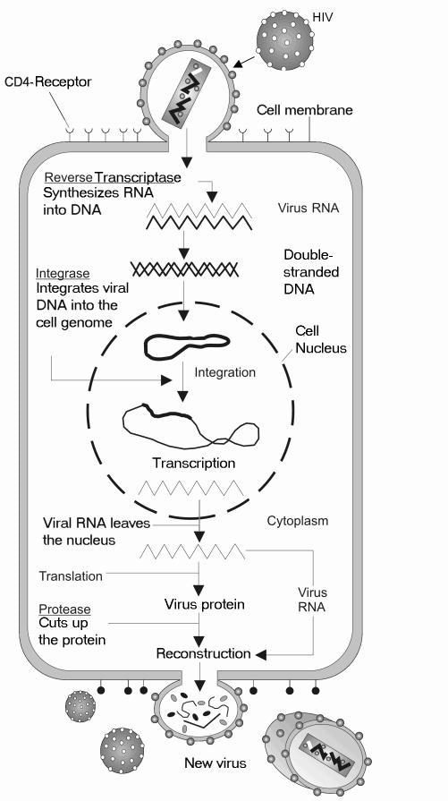

Slide 21
Infectivity
Viral entry
  Binding
  Fusion
  Injection of core into cell
Viral transfer
  Uncoating
  Making of single DNA strand from RNA using Reverse Transcriptase enzyme
  Making of second strand of DNA strand from template using DNA polymerase
  Integration into cellular DNA
  Viral protein synthesis
  Protein cleavage and viral assembly (RNA and proteins)
Viral exit
  Budding off from cell surface

Slide 22
HIV-1 Life cycle
gp41
gp120
Viral
assembly
HOST CELL
Translation
Protein
RNA and
cleavage
Glycosylation
reverse
NNRTIs & NRTI work here
transcriptase
Budding
Reverse
Protease
transcription
Transcription
Injection
of capsid
contents
PIs work here
Fusion inhibitors work here
RNA
DNA
Provirus
Integrase
(circular
Maturation
structure)
Integration of provirus
DNA into host DNA
Binding
HIV particle
Binding
sites
Completed
Cell
HIV particle
membrane

Slide 23
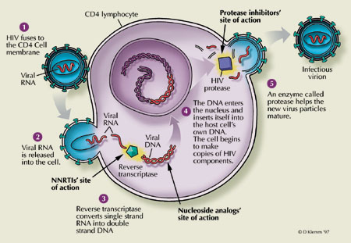
Mechanism of Action of ARVs
Protease Inhibitor
Integrase Inhibitor
Fusion
Inhibitor &
Chemokine
Receptor
Antagonist
NNRTI
NRTI
Illustration by David Klemm

Slide 24
WHO Clinical staging
WHO has developed a clinical staging system (originally for prognosis),based on clinical criteria.
The definition of symptoms, signs and diseases is according to clinical judgement.
Clinical condition or performance score, whichever is the higher, determines whether a patient is at clinical stage 1,2,3 or 4 .
Clinical stage is important was a criterion for starting antiretroviral (ARV) therapy.
Notes:
Based on two criteria:
Presentation of opportunistic infections and/or clinical situation
Immunological picture (CD4⁺ cells count)
Patient classified into four stages (I to IV)
Stage I very fine
Stage IV very sick

Slide 25
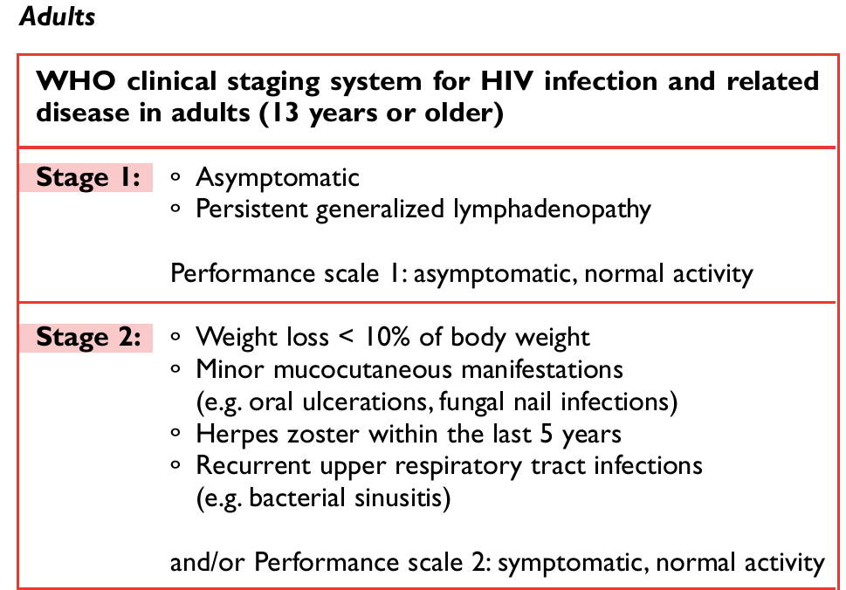

Slide 26
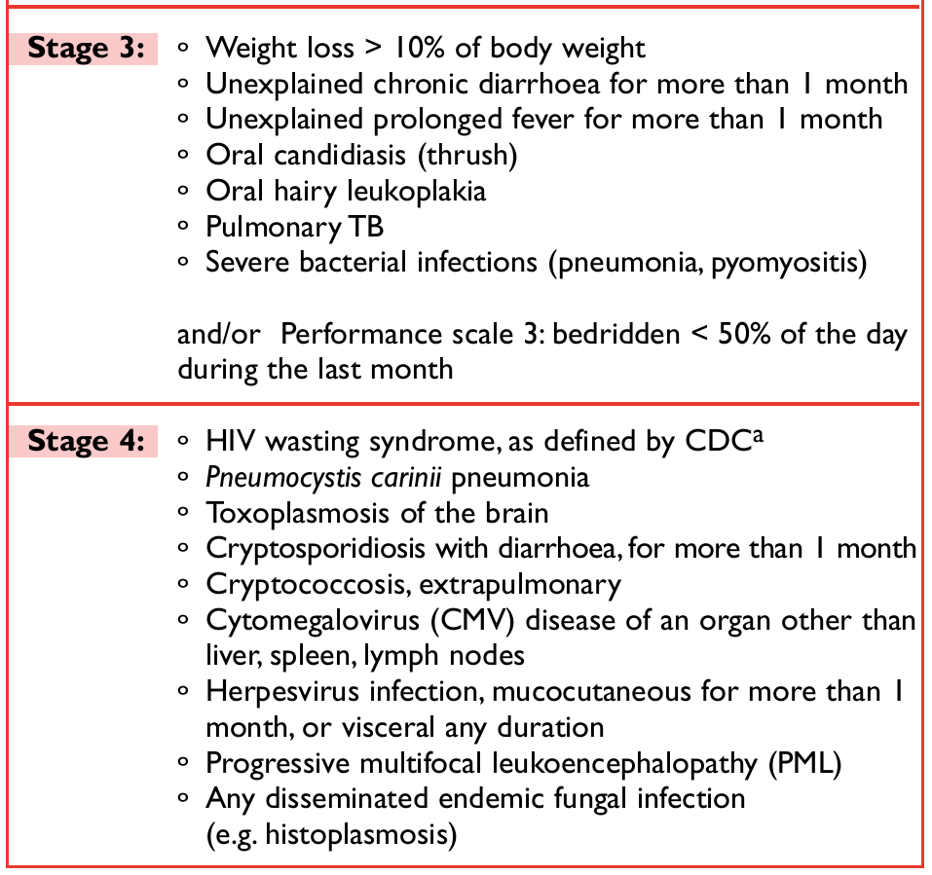

Slide 27
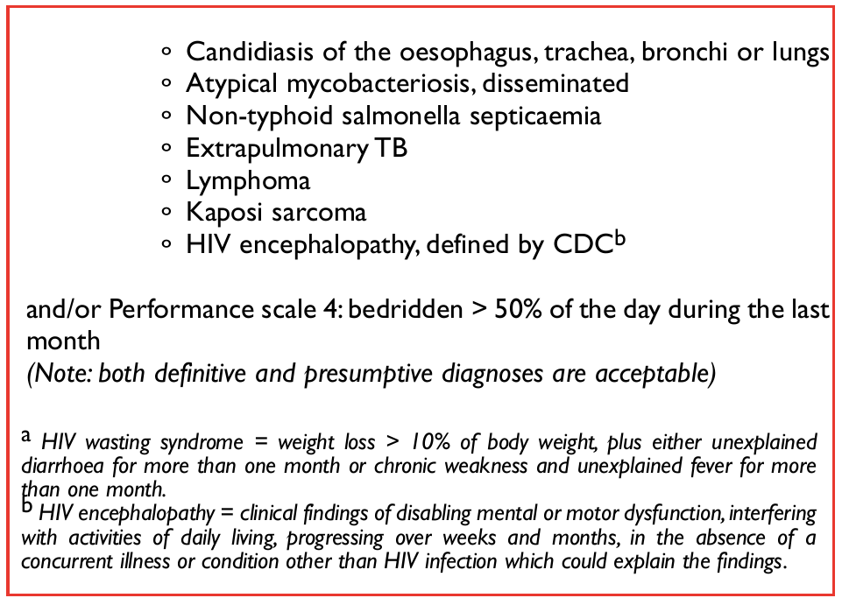

Slide 28
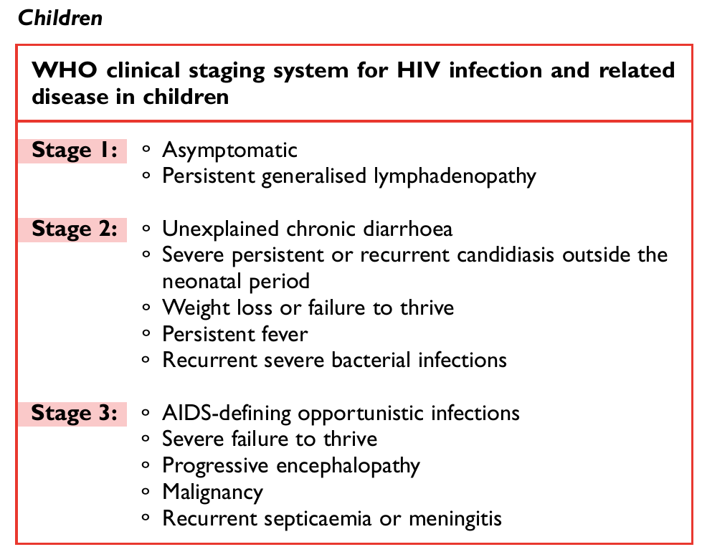

Slide 29
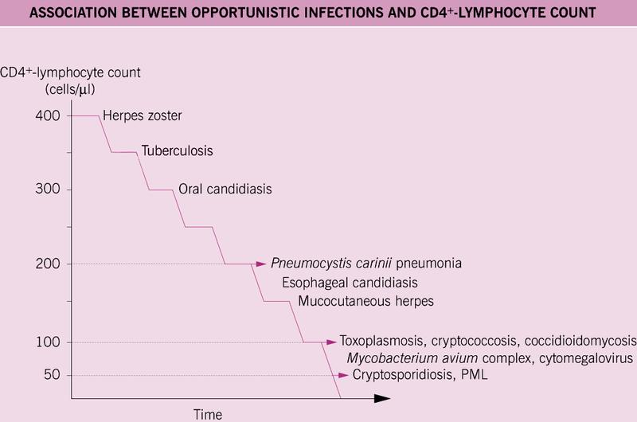

Slide 30
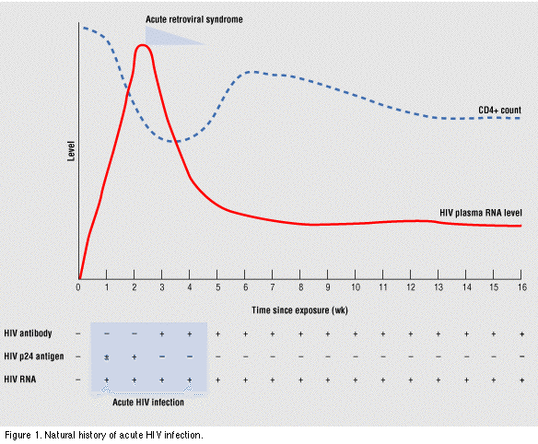
HIV infection and immune response

Slide 31
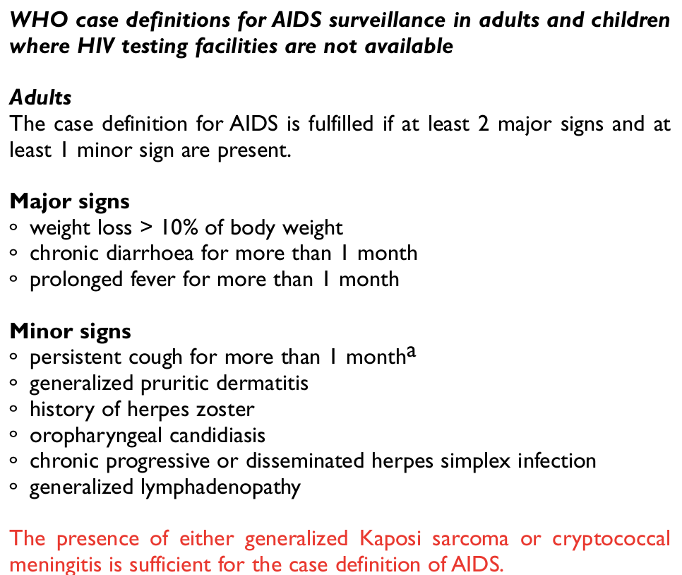

Slide 32
Transmission of HIV
Principally through body fluids contact and mucous membranes
Sexual – most common mode of transmission globally
Risk per episode
  Receptive vaginal intercourse: 0.1–0.2%
  Receptive anal intercourse: 0.1–3%
  Penetrative vaginal intercourse: 0.1%
  Penetrative anal intercourse: 0.06%
  Receptive oral intercourse: 0.04%

Slide 33
Transmission of HIV
Vertical transmission (mother to un-born child)
  >30% in absence of PMTCT (90% of all infections in children)
  ~14% in presence of PMTCT
Blood transfusion
Injection drug abuse
Sexual and gender-based violence

Slide 34
HIV testing
HIV infection leads to presence of several biological indicators of
  Viral infection
  Viral replication
These biological indicators can be used for
  Diagnosis
  Monitoring purposes
Targets the immunoglobulin and antibodies against gp120 and gp41
Alternative is direct virus amplification

Slide 35
HIV testing methods
Serological methods
  Antibodies screening methods
  ELISA
Rapid tests
  Stat pack
  Determine
  Unigold
Confirmatory methods
  ELISA
Viral detection methods
  DNA PCR

